Slide 1
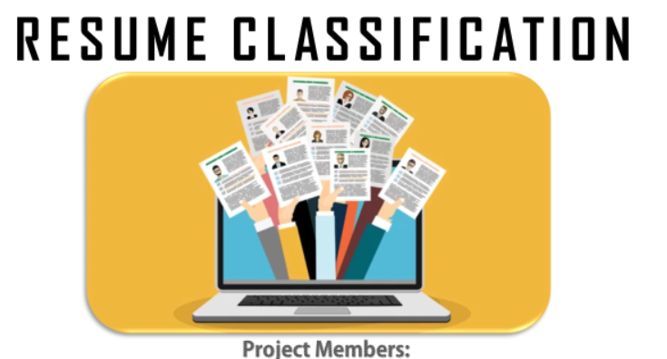
1) Sanket Dholi 2) Krishna Biju
3) Chandana Sonti 4) Mahesh Rathod
5) Kavita Sharma

Slide 2
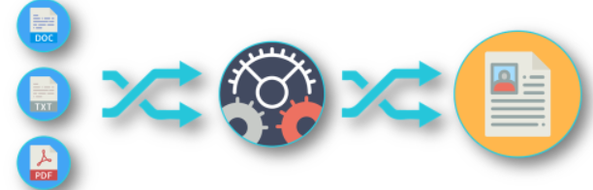
BUSINESS OBJECTIVE
The document classification solution should significantly reduce the manual human effort in the HRM. It should achieve a higher level of accuracy and automation with minimal human intervention
Abstract:-
A resume is a brief summary of your skills and experience. Companies recruiters and HR teams have a tough time scanning thousands of qualified resumes. Spending too many labor hours segregating candidates resume's manually is a waste of a company's time, money, and productivity. Recruiters, therefore, use resume classification in order to streamline the resume and applicant screening process. NLP technology allows recruiters to electronically gather, store, and organize large quantities of resumes. Once acquired, the resume data can be easily searched through and analyzed.
Resumes are an ideal example of unstructured data. Since there is no widely accepted resume layout, each resume may have its own style of formatting, different text blocks and different category titles. Building a resume classification and gathering text from it is no easy task as there are so many kinds of layouts of resumes that you could imagine

Slide 3
﻿INTRODUCTION
In this project we dive into building a Machine learning model for Resume Classification using Python and basic Natural language processing techniques. We would be using Python's libraries to implement various NLP (natural language processing) techniques like tokenization. lemmatization, parts of speech tagging, etc.
A resume classification technology needs to be implemented in order to make it easy for the companies to process the huge number of resumes that are received by the organizations. This technology converts an unstructured form of resume data into a structured data format. The resumes received are in the form of documents from which the data needs to be extracted first such that the text can be classified or predicted based on the requirements. A resume classification analyzes resume data and extracts the information into the machine readable output. It helps automatically store, organize, and analyze the resume data to find out the candidate for the particular job position and requirements. This thus helps the organizations eliminate the error-prone and time-consuming process of going through thousands of resumes manually and aids in improving the recruiters' efficiency.
The basic data analysis process is performed such as data collection, data cleaning, exploratory data analysis, data visualization, and model building. The dataset consists of two columns, namely, Role Applied and Resume, where 'role applied' column is the domain field of the industry and 'resume' column consists of the text extracted from the resume document for each domain and industry.
The aim of this project is achieved by performing the various data analytical methods and using the Machine Learning models and Natural Language Processing which will help in classifying the categories of the resume and building the Resume Classification Model.

Slide 4
This involves cleaning and preparing text data for analysis. It typically includes tasks like removing punctuation, converting text to lowercase, and handling special characters.
Tokenization is the process of splitting text into smaller units called tokens. These tokens can be words, phrases, or other meaningful elements. For example, tokenizing the sentence "Hello, how are you?" would result in tokens like "Hello", ",", "how", "are", "you", and "?".
Stop words are common words that are often removed during text analysis because they typically don't carry significant meaning. Examples of stop words include "the", "is", "and", "in", etc.
A word cloud is a visual representation of text data, where the size of each word in the cloud corresponds to its frequency or importance in the text.
Stemming is the process of reducing words to their root or base form. For example, "running", "ran", and "runs" would all be stemmed to "run".
Like stemming, lemmatization also reduces words to their base form, but it does so using a vocabulary and morphological analysis of words. This often results in more accurate results compared to stemming.
Count vectorization is a technique used to convert text data into numerical vectors, where each vector represents the count of words in the text. Each dimension in the vector corresponds to a unique word in the vocabulary.
Sentiment analysis is the process of determining the sentiment or opinion expressed in a piece of text. Polarity refers to the positivity or negativity of the sentiment expressed.

Slide 5
Exploratory Data Analysis
Exploratory Data Analysis (EDA) is a method used to study and explore datasets to understand their main characteristics, discover patterns, locate outliers and identify relationships between variables. EDA is usually carried out as a preliminary step before undertaking more formal statistical analyses or modeling
Visualization: Create visually appealing charts, graphs, and dashboards to present insights from the document classification process. For example, use bar charts to show the distribution of document categories, line charts to illustrate trends over time, and heatmaps to visualize correlations between document types.
Interactive Dashboards: Develop interactive dashboards that allow HR professionals to explore document categories, drill down into specific documents, and filter data based on various criteria. Tools like Tableau, Power BI, or Plotly Dash can be used for building such dashboards.
Text Analytics: Conduct text analytics to extract key information from HR documents and present it in a structured format. This could include identifying frequently occurring terms, sentiment analysis of employee feedback, or topic modeling to uncover common themes within documents.
Category Distribution: A bar chart showcasing the distribution of document categories, allowing HR professionals to quickly identify the most prevalent types of documents.
Trend Analysis: A line chart depicting the trend in document submissions over time, highlighting any seasonal patterns or spikes in activity.
Text Analysis Insights: Text clouds or word frequency charts displaying the most common terms or phrases within each document category, offering insights into the content of HR documents.

Slide 6
Model building involves choosing an appropriate algorithm or modelling technique that is suitable for the specific problem and dataset. The choice of the model depends on various factors such as the type of task (classification , regression, clustering, etc.), the nature of the data, the size of the dataset, and the desired interpretability or accuracy of the model. In this project we have tried using these models
Model Building
SVM: A support vector machine (SVM) is a type of supervised learning algorithm used to solve classification and regression tasks; SVM’s are particularly good at solving binary classification problems, which require classifying the elements of a data set into two groups.
AdaBoost: AdaBoost, short for Adaptive Boosting, is an ensemble machine learning algorithm that can be used in a wide variety of classification and regression tasks. It is a supervised learning algorithm that is used to classify data by combining multiple weak or base learners (e.g., decision trees) into a strong learner.
Bagging: Bagging, also known as ensemble learning method that is commonly used to reduce variance within a noisy data set. In bagging, a random sample of data in a training set is selected with replacement meaning that the individual data points can be chosen more than once.
Decision Tree: A decision tree is a tree-like model that acts as a decision support tool, visually displaying decisions and their potential outcomes, consequences, and costs. From there, the “branches” can easily be evaluated and compared in order to select the best courses of action.
Gradient Boosting: Gradient boosting is a popular boosting algorithm in machine learning used for classification and regression tasks. Boosting is one kind of ensemble Learning method which trains the model sequentially and each new model. It combines several weak learners into strong learners.
Navie Bayes: Navie bayes algorithms are often used in sentiment analysis, spam filtering, recommendation systems, etc. They are quick and easy to implement but their biggest disadvantage is that the requirement of predictors to be independent.

Slide 7
Takeways
Learned to handle data
Made text preprocessing automatic
Got better at visualizing data
Used vectorization methods
Tried different models
Worked well in a team and learned about deployment

Slide 8


Slide 9
Thank You

